Slide 1
Apollo Renal Therapeutics Water Filtration Project
Team 504
Kencin Autry, Matthew Kennedy, Timothy Norman,
Lapadre Proctor, Lily Thompson

Slide 2
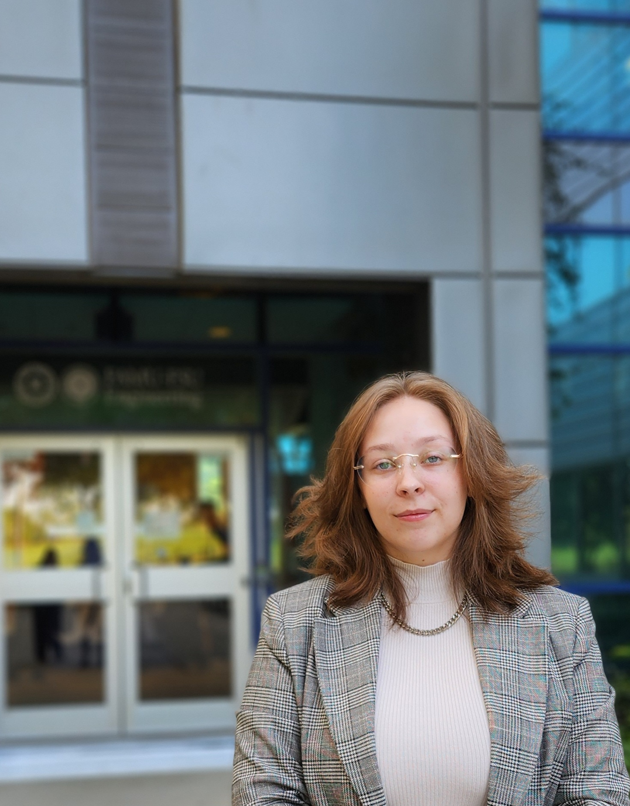
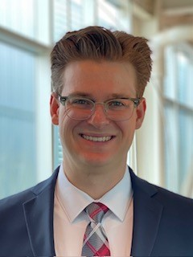
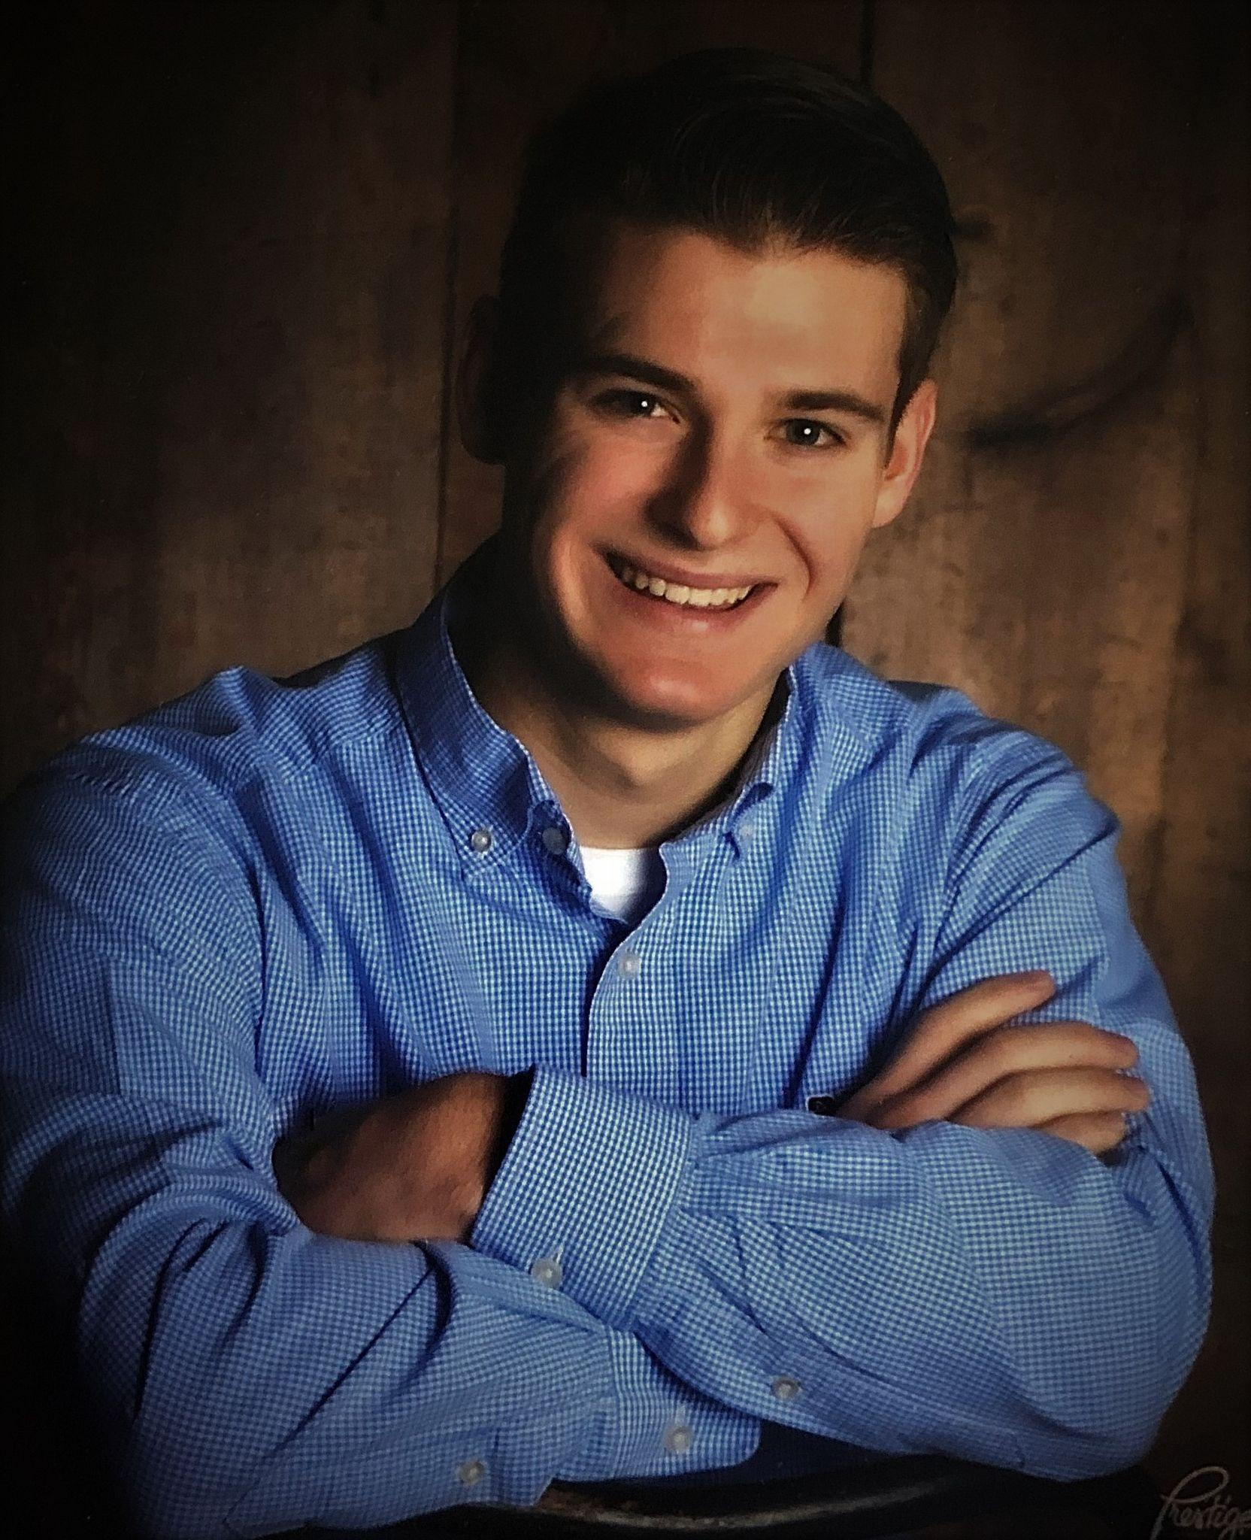
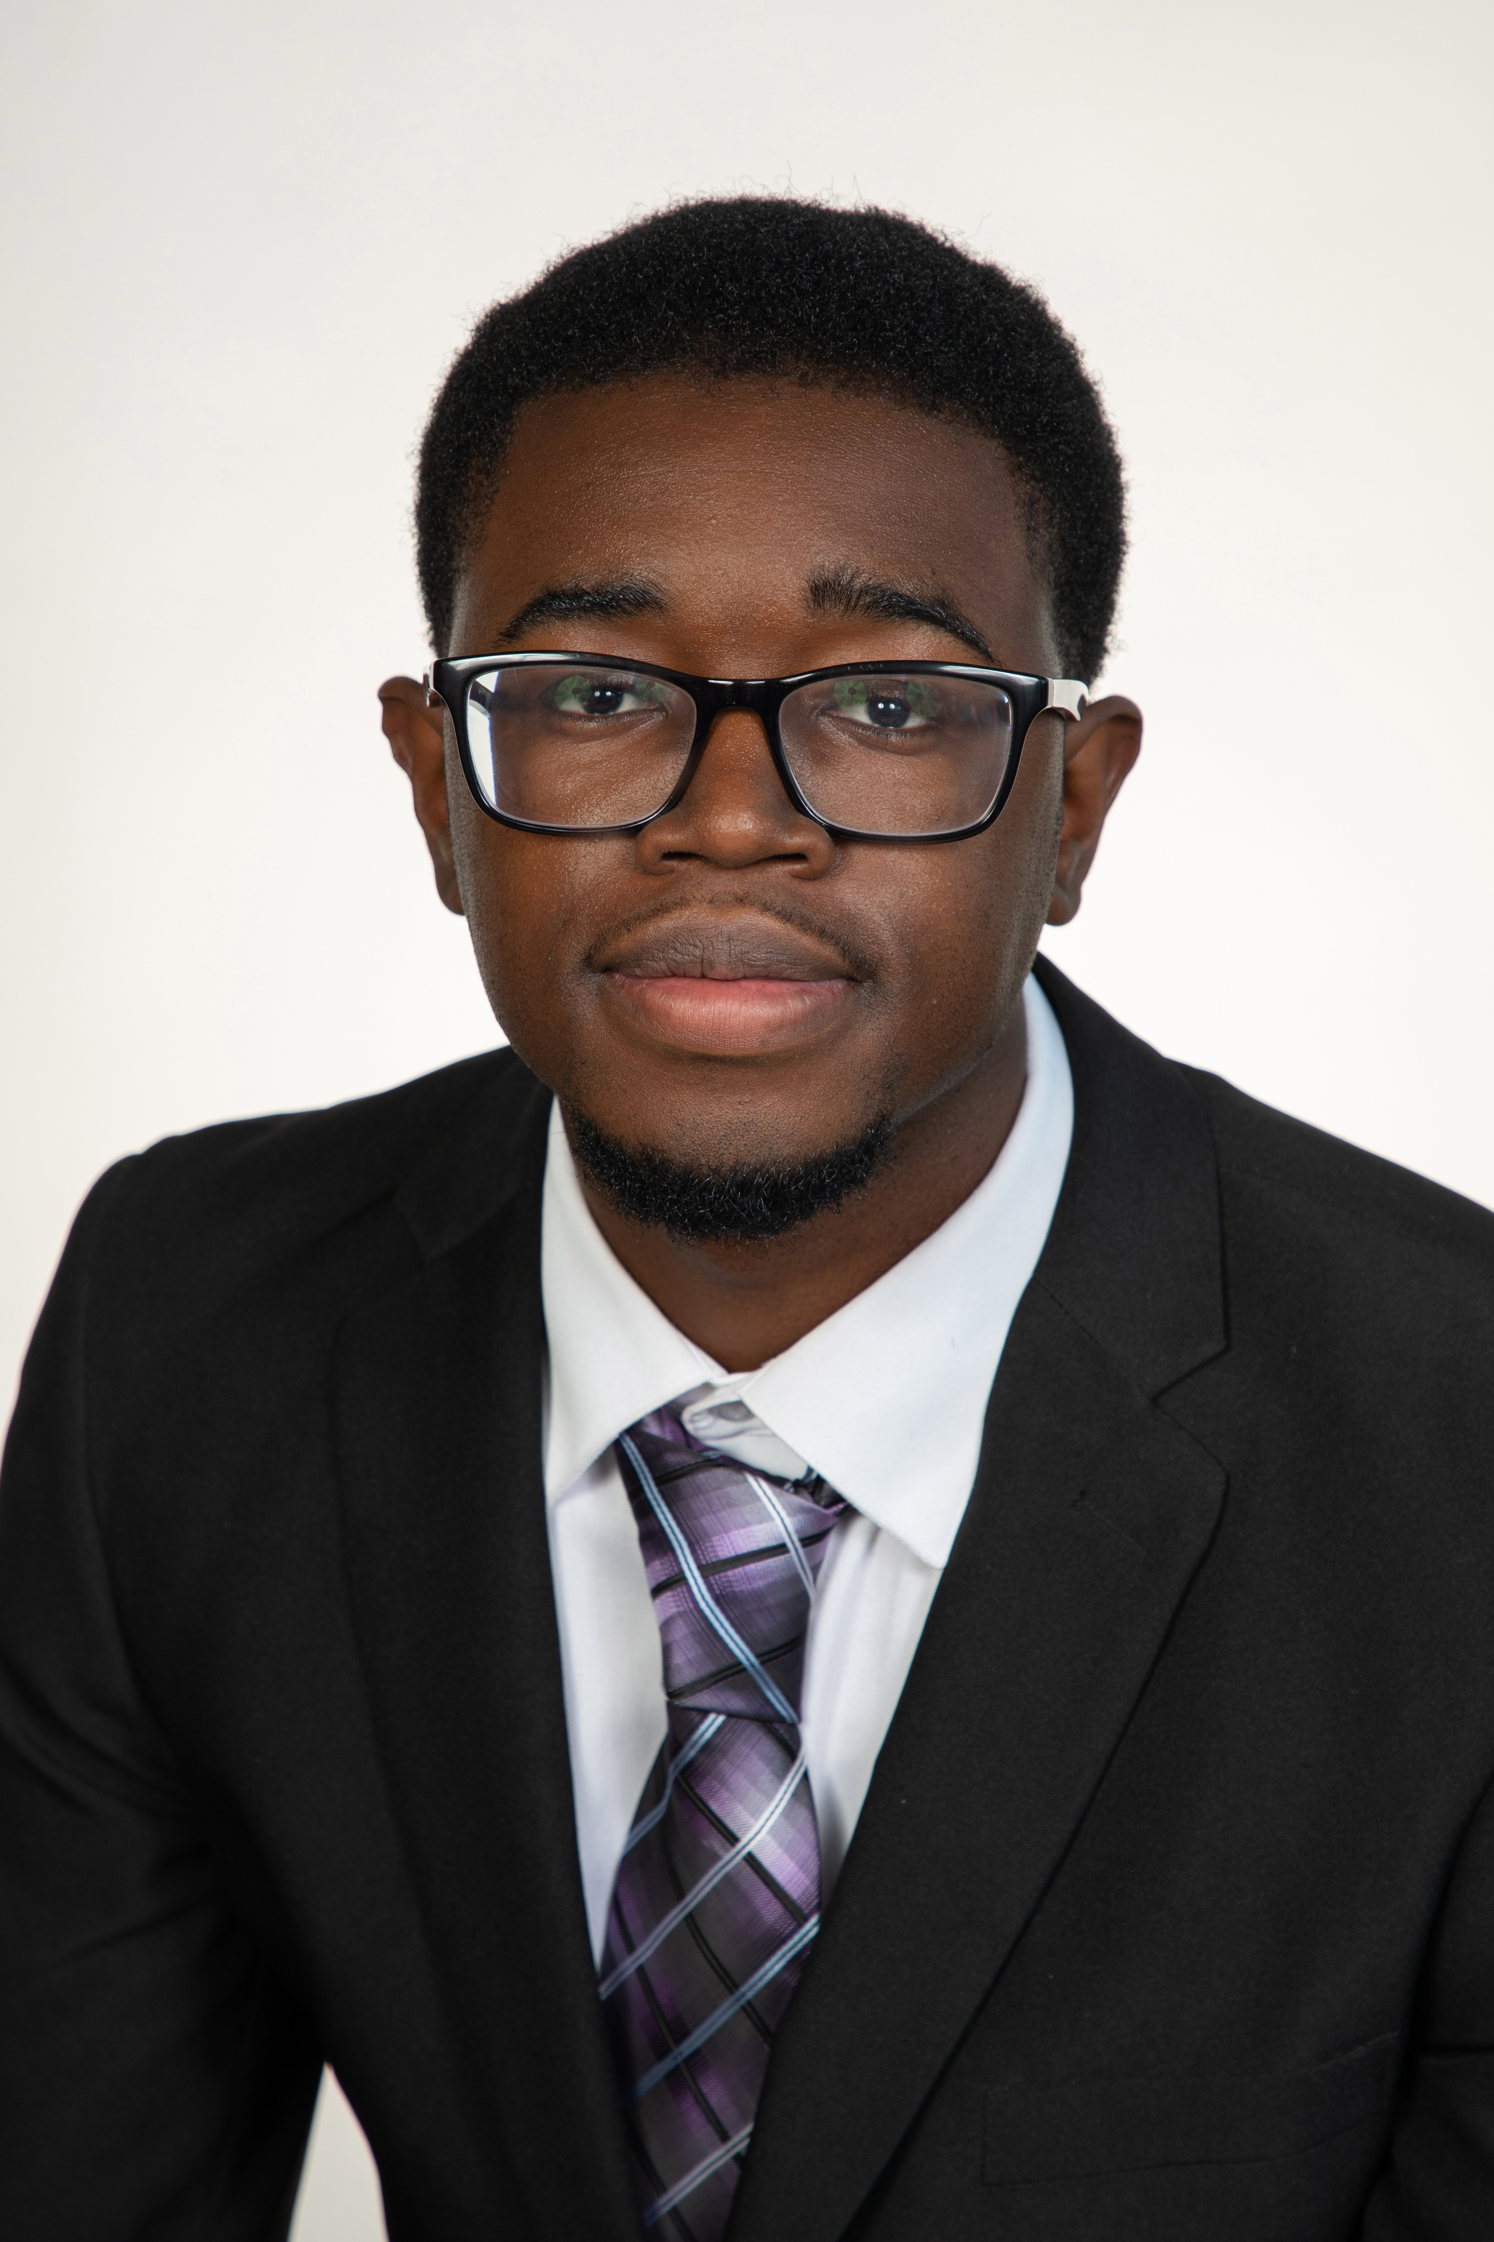
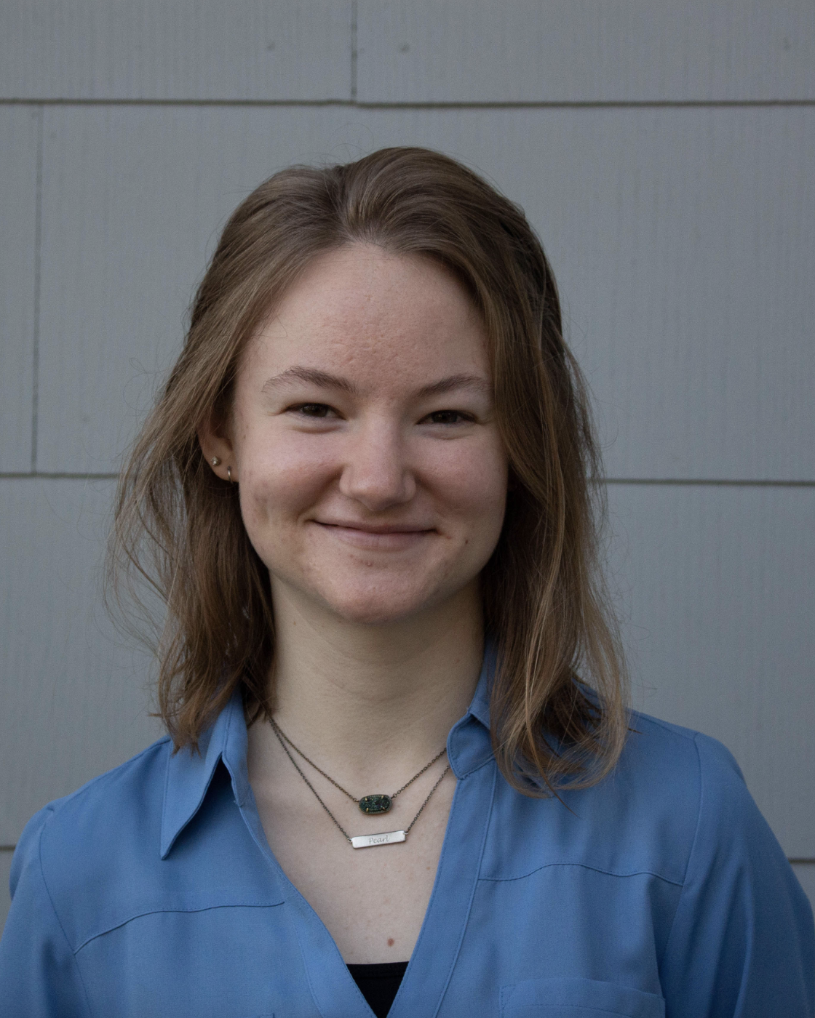
Lily Thompson
Team Introductions
Kencin Autry
Research
Development
Engineer
Matthew Kennedy
Structural Design
And Materials
Engineer
Timothy Norman
Structural Design
And Manufacturing
Engineer
Lapadre Proctor
Test and Quality
Control
Lily Thompson
Computational
Fluids Engineer
2
Notes:
*everything has to be in font given *Arial Black (from McConomy)
M

Slide 3
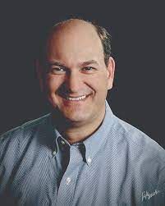
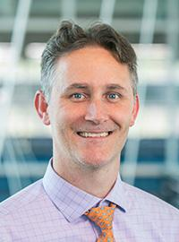
Lily Thompson
Sponsor and Advisor
Sponsor
Gary Mishkin
CEO Apollo Renal Therapeutics
DBA Artemis Plastics
Academic Advisor
Dr. Shayne McConomy
Senior Design Professor

Slide 4
Lily Thompson
Objective
The objective of this project is to reduce the quantity of waste-water in the dialysis process by efficiently purifying standardized filtered water and spent dialysate to ultra-pure water.
Notes:
l

Slide 5
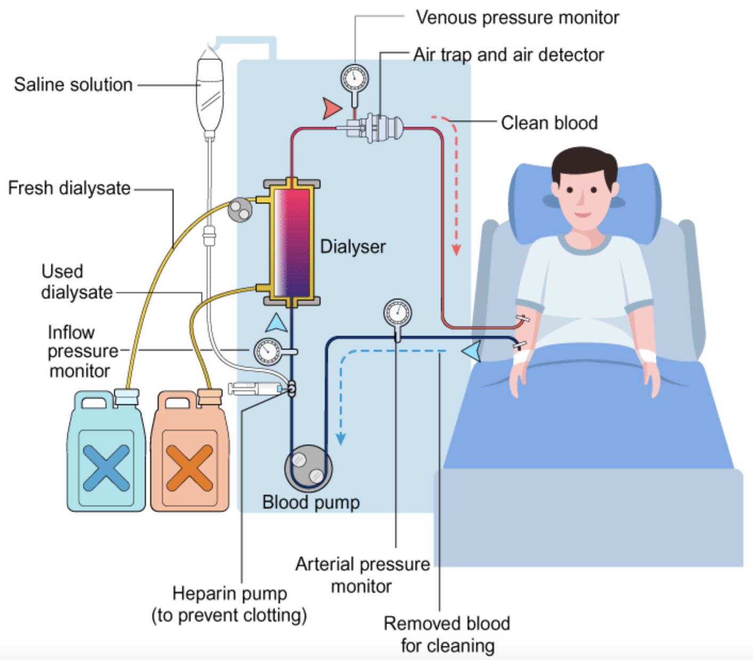
Lily Thompson
Project Background
Hemodialysis is a therapy treatment for patients with end-stage kidney disease (ESKD).
5

Slide 6
Lily Thompson
Project Background
A patient treated three times a week consumes around 24 tons of pure water per year.
A typical facility-based patient uses about 80 tons of tap water for hemodialysis.
6

Slide 7
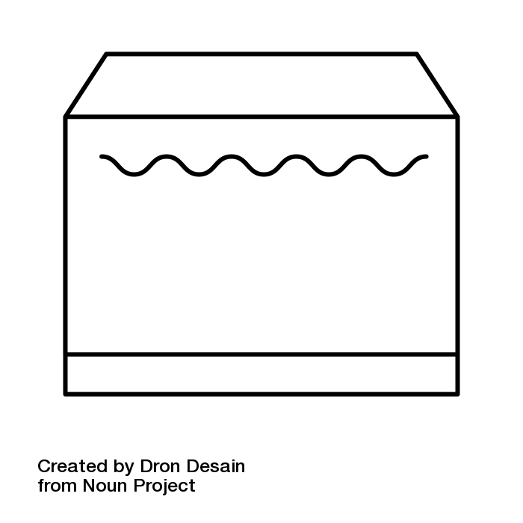
Motivation
Lily Thompson
Tap Water
Ultra-Pure Water
7
7

Slide 8
Motivation
Lily Thompson
Ultra-Pure Water
Dialyzer
Spent Dialysate
Ultra-Pure Water
c
c
c
8

Slide 9
Lily Thompson
Key Goals
Enhancing efficiency and preventing the potential hazards of large water filtration systems
Use the device at the home of patients
Recycling spent dialysate back into ultra-pure water
Filtered water will meet ultra-pure water standards
9

Slide 10
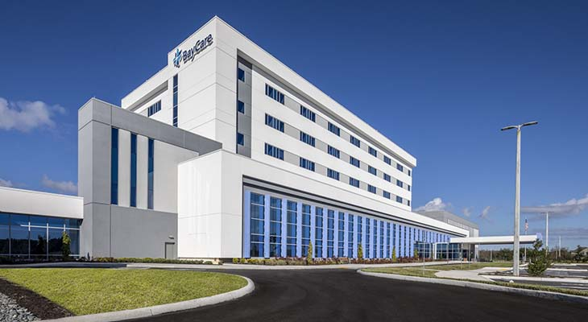
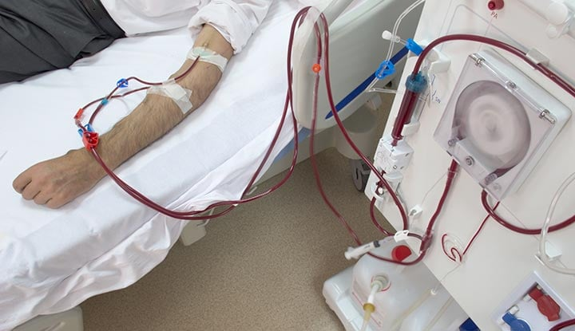
Timothy Norman
Primary Markets
Hospitals and Medical Care Facilities
At-home patients
10

Slide 11
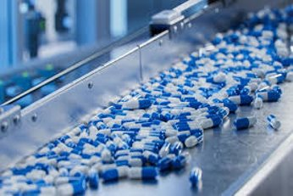
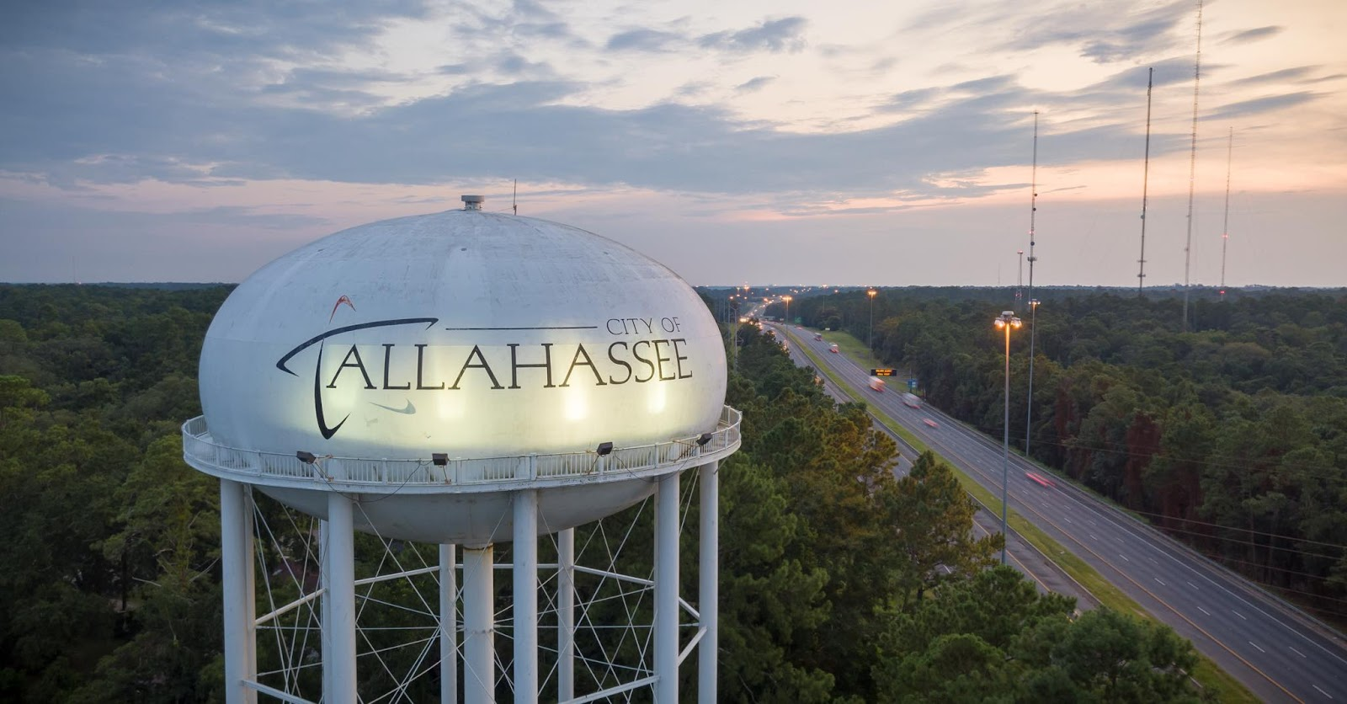
Timothy Norman
Secondary Markets
Nursing and Retirement Care
Pharmaceuticals
City Water Treatment
Food Manufacturing
11

Slide 12
Lily Thompson
Assumptions
Hemodialysis and peritoneal will be the main medical processes the system is used for
The system will only be used by one patient at a time
The incoming flow is laminar
12

Slide 13
Timothy Norman
Customer Needs
Design requires relatively low maintenance and will last approximately 1 year
Design should fit into a space no larger than 10 in x 12 in x 5 in
Must be universally compatible
Handle a maximum flow rate of 1000 mL per minute
Produce Ultra-Pure water
13
13
13

Slide 14
Functional Decomposition
Timothy Norman
Contaminant Detection
Software
Inputs Given Speed and Pressure
Reading Data
DAQ
Water Pressure and Water Speed
Hardware
Gathering Data
Raising/Lowering Speed
pH Level
Reads pH
Connecting Voltage Source
Power and Flow
Filter System
Flow
Incoming and Outgoing
Purify
Turning Water to Ultra-Purified
Transmitting Ultra-Purified to Dialyzer
Recycling Spent Dialysate
Storing Ultra-Purified
Liquid Storage
Storing Toxins
Storing Spent Dialysate
Reducing Weight
Packaging
Limiting Dimensions
Maintenance
Preventing Fouling
Feasibility
Compatibility
Using Universal Connector
14
Notes:
Just focus on priority functions as defined by the cross reference chart

Slide 15
Timothy Norman
Functional Decomposition
Purify
Turning Water to Ultra-Purified
Transmitting Ultra-Purified to Dialyzer
Recycling Spent Dialysate
15

Slide 16
Timothy Norman
Functional Decomposition
Storing Ultra-Purified
Liquid Storage
Storing Toxins
Storing Spent Dialysate
16

Slide 17
Timothy Norman
Functional Decomposition
Connecting Voltage Source
Power and Flow
Incoming
Flow
Outgoing
17

Slide 18
Functional Decomposition
Timothy Norman
Contaminant Detection
DAQ
Software
Inputs Given Speed and Pressure
Reading Data
Water Pressure and Water Speed
Hardware
Gathering Data
Raising/Lowering Speed
pH Level
Reads pH

Slide 19
Functional Decomposition
Timothy Norman
Contaminant Detection
Water Pressure and Water Speed
DAQ
pH Level

Slide 20
Functional Decomposition
Timothy Norman
Software
Contaminant Detection
DAQ
DAQ
Water Pressure and Water Speed
Hardware
pH Level
Reads pH

Slide 21
Functional Decomposition
Timothy Norman
Inputs Given Speed and Pressure
Contaminant Detection
DAQ
Software
Water Pressure and Water Speed
Hardware
pH Level
Reads pH
Gathering Data

Slide 22
Functional Decomposition
Timothy Norman
Reading Flow Data
Contaminant Detection
DAQ
Software
Inputs Given Speed and Pressure
Water Pressure and Water Speed
Hardware
Gathering Data
pH Level
Reads pH
Raising and Lowering Speed

Slide 23
Timothy Norman
Functional Decomposition
Reducing Weight
Packaging
Limiting Dimensions
23

Slide 24
Functional Decomposition
Timothy Norman
Maintenance
Preventing Fouling
Feasibility
Compatibility
Using Universal Connector

Slide 25
Future Work
Timothy Norman
Concept Selection and
Sponsor Approval
Benchmarking and Secondary Dialysis Research
Concept
Selection
Concept Generation and Initial Prototyping
Final Prototype Modeling and Preliminary Materials Research
25
Notes:
Micheal gave some advice on what to include outside of just assignment names, this is just a format idea

Slide 26
LinkedIn
Thank You
Kencin Autry
Matt Kennedy
Lily Thompson
Lapadre Proctor
Timothy Norman
Notes:
Add groups linked in info in QR code

Slide 27
Backup Slides

Slide 28
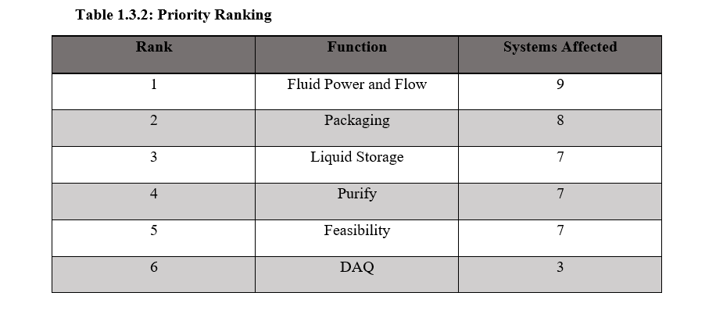
Functional Decomp Priority Rating

Slide 29
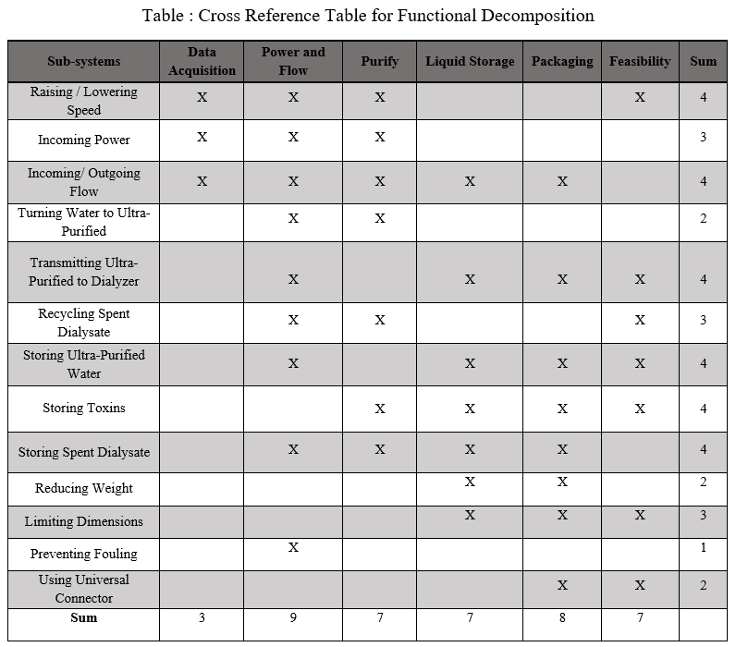
Functional Decomp Cross Reference

Slide 30
Calculations for Laminar Flow
$$ρ=1000 \frac{kg}{m^{3}} , v= ?, average diameter of a nanotube d=2.0 x {10}^{−9} ,$$
$$μ=0.0008891 \frac{N∗s}{m^{2}}$$
$Re$ = $\frac{ρvd}{μ}$
To find the velocity:
Given, by our customer, a flow rate of $1000 \frac{mL}{min}$
1000 ${mL}/{min}$ $→$ converted to $1.67 x {10}^{−5}{m^{3}}/s$
$1.67 x {10}^{−5}{m^{3}}/s$ $→$ converted to $5.32 x {10}^{3}\frac{m}{s}$
$$Re= \frac{(1000 \frac{kg}{m^{3}})(5.32 x {10}^{3}\frac{m}{s})(2.0 x {10}^{−9})}{(0.0008891 \frac{N∗s}{m^{2}})}$$
$Re≈12$, indicating a Laminar Flow

Slide 31
Standards for Ultra-Pure Water
Ultrapure water (UPW) is water that has been purified to high levels of specification:
Extremely low total dissolved solids (TDS) level
High electrical resistivity
Free from chloride, sulfate, sodium, calcium, magnesium
Minimal levels of organic contaminants, > 1 ppb

Slide 32
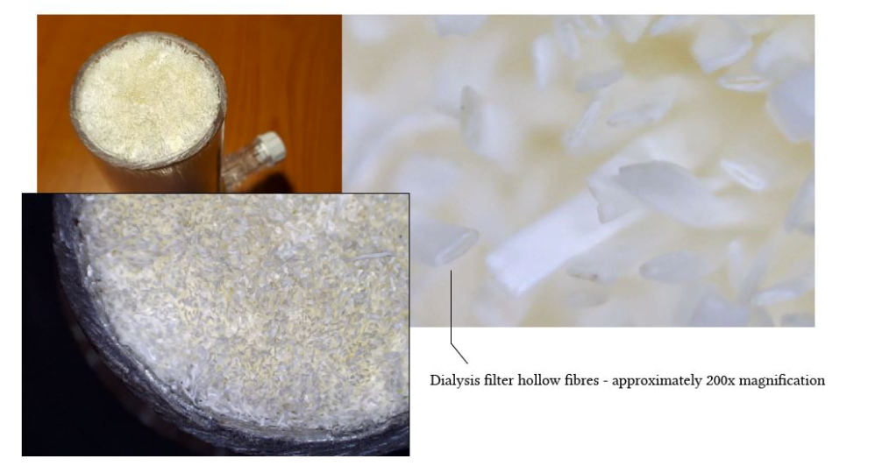
What a Dialyzer Looks Like

Slide 33
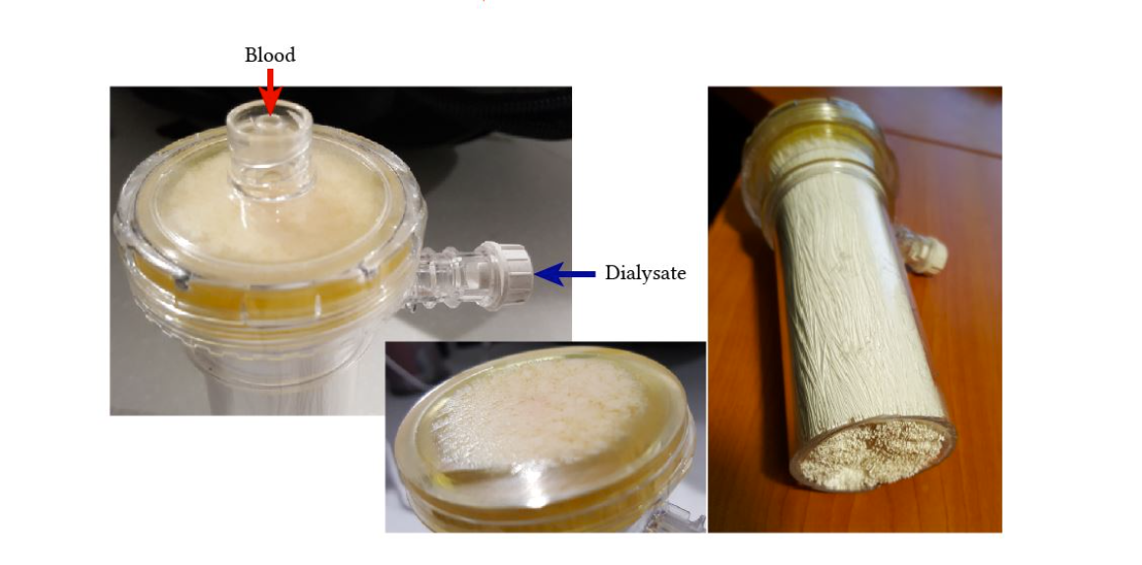

Slide 34
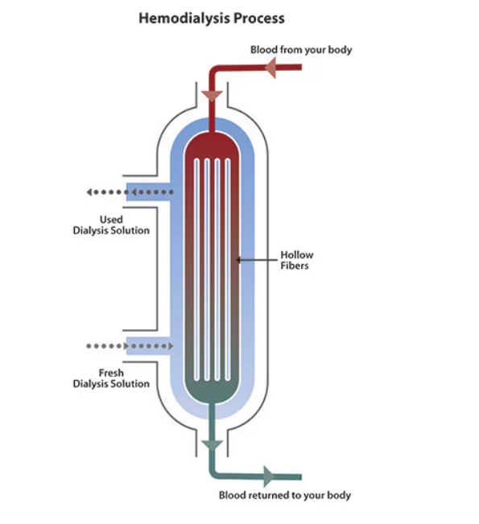

Slide 35
Hemodialysis and Peritoneal
Hemodialysis is ongoing dialysis (3 to 5 times a week) that cleans your blood, usually in a dialysis center. The hemodialysis access is in your arm.
Peritoneal dialysis is ongoing dialysis (daily) that collects waste from the blood by washing the empty space in the abdomen (peritoneal cavity). It can be done from home. The access for this is in your abdomen.

Slide 36
Reasons Why
The spent dialysate is a highly saline liquid consisting of urea, creatinine, uric acid, phosphate, etc.
A major challenge for the reuse of spent dialysate is removal of urea, the main nitrogenous waste product.
Due to its small molecular weight (60 Da) and electroneutral nature, it is difficult to be removed by sorbents.
Key Drawbacks:
System complexity
High energy cost
Membrane fouling and scaling

Slide 37
Objective
The objective of this project is to reduce the quantity of waste-water in the dialysis process by efficiently purifying standardized filtered water and spent dialysate to ultra-pure water.

Slide 38
Project Background
Hemodialysis is a therapy treatment for patients with end-stage kidney disease (ESKD).
Notes:
Give context on hemodialysis and how it operates could just be a diagram but speaker will need to be prepared
After the first bullet point talk about how the diayser in the picture acts as a kidney for the patient passing their blood through and extracting the toxins from their blood

Slide 39
Project Background
A patient treated three times a week consumes around 24 tons of pure water per year.
A typical facility-based patient uses about 80 tons of tap water for hemodialysis.
Notes:
A patient treated three times a week consumes around 24 tons of pure water per year (Nystrand, 2008).
A typical facility-based patient uses about 80 tons of tap water for hemodialysis (Agar, 2010).
Id like to put facts on this slide about how much is wasted and yeah what hemodialysis is and what the filtration system does can be explained on the next slide with the diagram

Slide 40
Motivation
Tap Water
Ultra-Pure Water
Notes:
Brown dot now on both sides

Slide 41
Motivation
Ultra-Pure Water
Dialyzer
Spent Dialysate
Ultra-Pure Water
c
c
c
Notes:
Decide on colors (show waste in filter again )

Slide 42
Key Goals
Enhancing efficiency and preventing the potential hazards of large water filtration systems
Use the device at the home of patients
Recycling spent dialysate back into ultra-pure water
Filtered water will meet ultra-pure water standards

Slide 43
Primary Markets
Hospitals and Medical Care Facilities
At-home patients

Slide 44
Secondary Markets
Nursing and Retirement Care
Pharmaceuticals
City Water Treatment
Food Manufacturing

Slide 45
Assumptions
Hemodialysis and peritoneal will be the main medical processes the system is used for
The system will only be used by one patient at a time
The flow is laminar
Notes:
*not a fan of this color?

Slide 46
Customer Needs
Design requires relatively low maintenance and will last approximately 1 year
Design should fit into a space no larger than 10 in x 12 in x 5 in
Must be universally compatible/connectable
Handle a maximum flow rate of 1000 mL per minute
Produce Ultra-Pure water
46
46

Slide 47
Functional Decomposition
Connecting Voltage Source
Power/Flow
Incoming
Flow
Outgoing

Slide 48
Functional Decomposition
Storing Ultra-Purified
Liquid Storage
Storing Toxins
Storing Spent Dialysate

Slide 49
Functional Decomposition
Reducing Weight
Packaging
Limiting Dimensions

Slide 50
Future Work
Concept Generation
Sponsor Approval
Modeling
Benchmarking
Secondary Dialysate Research
Notes:
*look at more interesting cohesive design

Slide 51
This is 10-point
This is 15–point Times
This is 20–point
This is 25–point
This is 30–point
This is 35–point
This is 40–point
This is 50–point
This is 60–point
This is 72–point
Notes:
Use at least 20-point font in Room A105, B134, and B136
Use at least 25-point font in Room B135

Slide 52
Notes:
Just optional animated slide for some tiered info

Slide 53
Blah blah blah
Blah blah blah
Blah blah blah

Slide 55
Notes:
Filter process design

Slide 57
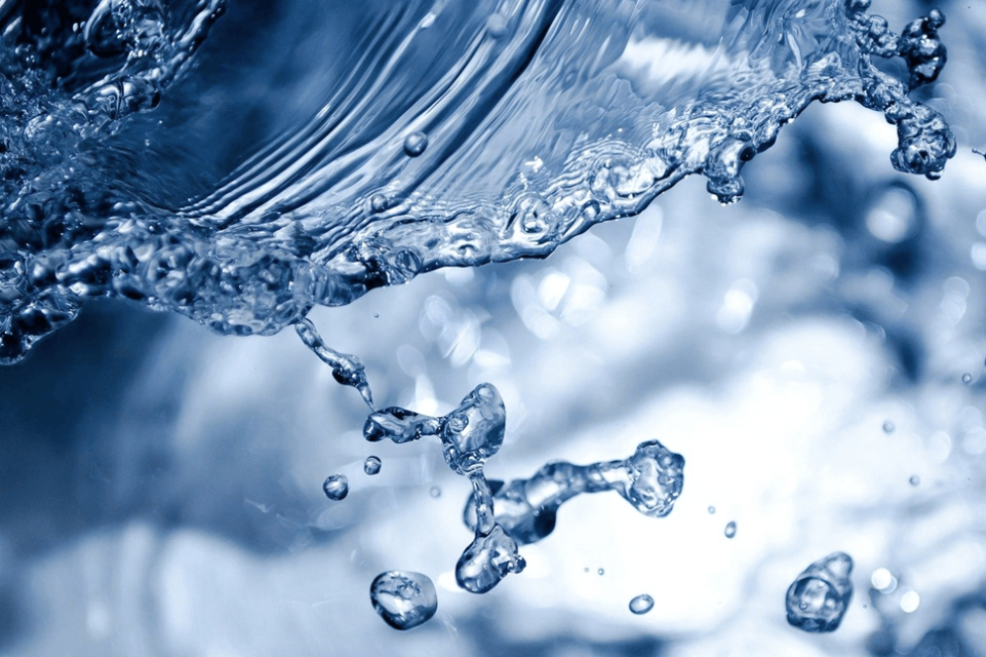
Thank You
Notes:
Idk make prettier pls * icons go back to slide sections as shown

Slide 58
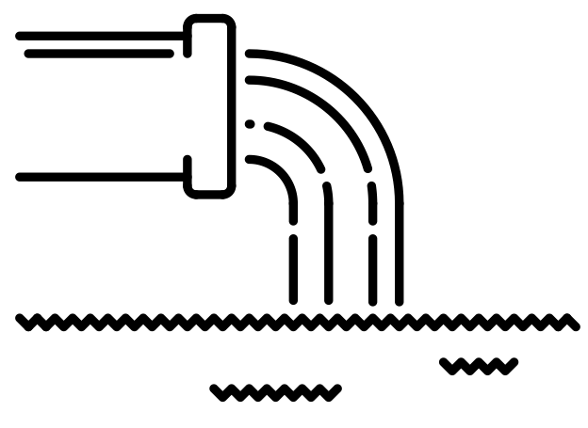
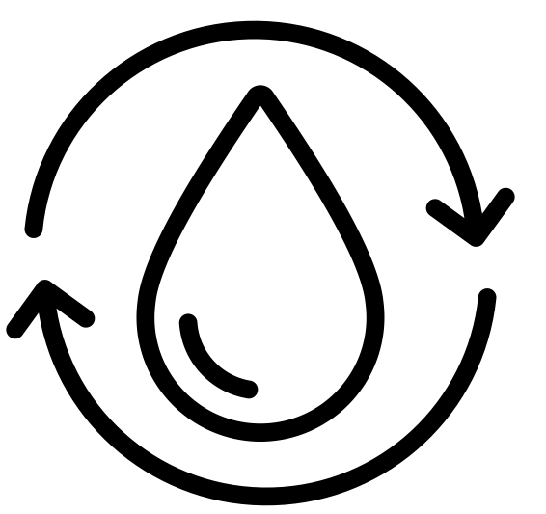
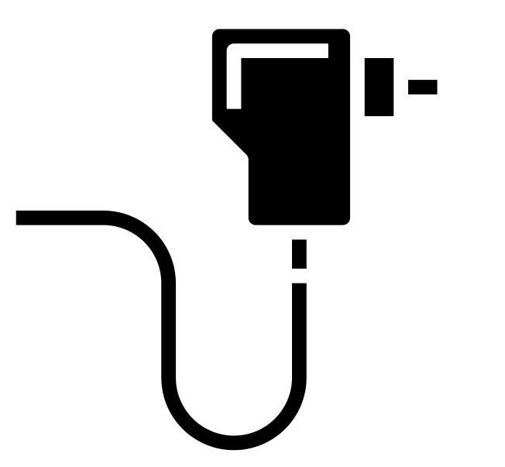
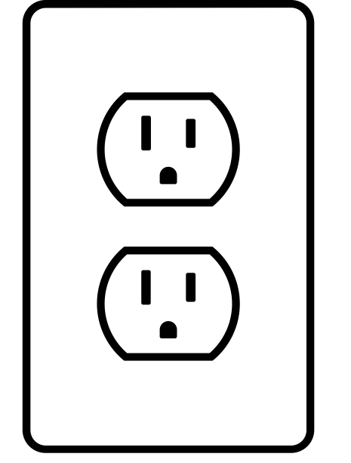
Logos and icons

Slide 59
College of Engineering Color Palette
1 2 3 4
Pantone: PMS 195 C
RGB: 120, 47, 64
Hex: #782F40
CMYK:19, 90, 50, 55
1 2 3 4
Pantone: Black C
RGB: 0, 0, 0
Hex: #000000
CMYK:0, 0, 0, 100
Garnet
Black
1 2 3 4
RGB: 238, 118, 36
Hex: #EE7624
CMYK:2, 66, 99, 0
1 2 3 4
Pantone: PMS 000C
RGB: 255, 255, 255
Hex: #FFFFFF
CMYK: 0, 0, 0, 0
Fang
Orange
White
Notes:
Avoid 75% Black in B135

Slide 60
Accent Color Palette
1 2 3 4
RGB: 0, 59, 111
Hex: #003B6F
CMYK:
1 2 3 4
RGB: 0, 59, 111
Hex: #003B6F
CMYK:
1 2 3 4
RGB: 251, 236, 93
Hex: #FBEC5D
CMYK:
1 2 3 4
RGB: 219, 215, 210
Hex: #DBD7D2
CMYK:
1 2 3 4
RGB: 251, 236, 93
Hex: #FBEC5D
CMYK:
1 2 3 4
RGB: 219, 215, 210
Hex: #DBD7D2
CMYK:
Tardis Blue
Tardis Blue
Corn
Timberwolf
Corn
Timberwolf
1 2 3 4
RGB: 206, 0, 88
Hex: #CE0058
CMYK: 0, 100, 43, 12
1 2 3 4
RGB: 206, 0, 88
Hex: #CE0058
CMYK: 0, 100, 43, 12
1 2 3 4
RGB: 104, 40, 96
Hex: #682860
CMYK:
1 2 3 4
RGB: 220, 220, 220
Hex: #DCDCDC
CMYK:
Rubine Red
Rubine Red
Imperial
Gainsboro
1 2 3 4
RGB: 72, 146, 155
Hex: #48929b
CMYK:
1 2 3 4
RGB: 64, 224, 208
Hex: #40E0D0
CMYK:
1 2 3 4
RGB: 255, 139, 0
Hex: #FF8B00
CMYK:
Asagi-iro
Turquoise
American Orange
Notes:
Remove American orange add hyperlink grey
Make corn the last for b135
All work in 134 imperial move later
Tardis doesn’t work in b136

Slide 61
F7AB19
D67F15
EE7624
D64615
F73119
Analogous
https://color.adobe.com/create/color-wheel
6E3610
F0A16C
EE7624
6E4931
BASB1C
Monochromatic
A14508
4BED3B
EE7624
250CED
2010A1
Triad
A1470C
FF8C40
EE7624
0098A1
24E2ED
Complementary
28A164
2FED8D
EE7624
0848A1
1871ED
Split Complementary
EDAC2F
3BED93
EE7624
0C6AED
ED2F18
Double Split Complementary
ED660C
C7ED3B
EE7624
0CE1ED
A418ED
Square
BA7E09
87724A
EE7624
60EFCF
09BA61
Compound
AD551A
6E3610
EE7624
FA7625
D46820
Shades
Notes:
These are the variants that work well with Fang Orange. The bolded items show well on the projectors.

Slide 62
85412D
8F3831
782f40
8F3176
792D85
Analogous
https://color.adobe.com/create/color-wheel
C44D69
8E626D
782F40
C48796
451B25
Monochromatic
C43959
78743B
782F40
236178
43A2C4
Triad
C43959
C46078
782F40
25C43D
2F783A
Complementary
93C460
577835
782F40
39C49D
297861
Split Complementary
784435
5A783B
782F40
237860
6E2978
Double Split Complementary
782337
78683b
782F40
237830
293978
Square
AB4D32
DEBAAF
782F40
5D8555
70AB32
Compound
38161E
C44D69
782F40
853447
5E2532
Shades

Slide 63
A105
A105
B135 Stage Left
B135 Stage Right
B136
B134, A105
B135

Slide 69
Citations
blood dialysis by Andy Horvath from <a href="https://thenounproject.com/browse/icons/term/blood-dialysis/" target="_blank" title="blood dialysis Icons">Noun Project</a> (CC BY 3.0)
Kidney by Febrian Hidayat from <a href="https://thenounproject.com/browse/icons/term/kidney/" target="_blank" title="Kidney Icons">Noun Project</a> (CC BY 3.0)
Dialysis Machine by bsd studio from <a href="https://thenounproject.com/browse/icons/term/dialysis-machine/" target="_blank" title="Dialysis Machine Icons">Noun Project</a> (CC BY 3.0)
Dialysis Machine by Gan Khoon Lay from <a href="https://thenounproject.com/browse/icons/term/dialysis-machine/" target="_blank" title="Dialysis Machine Icons">Noun Project</a> (CC BY 3.0)
filter by Smalllike from <a href="https://thenounproject.com/browse/icons/term/filter/" target="_blank" title="filter Icons">Noun Project</a> (CC BY 3.0)
filter by Kiran Shastry from <a href="https://thenounproject.com/browse/icons/term/filter/" target="_blank" title="filter Icons">Noun Project</a> (CC BY 3.0)
filter by Kiran Shastry from <a href="https://thenounproject.com/browse/icons/term/filter/" target="_blank" title="filter Icons">Noun Project</a> (CC BY 3.0)
Waste by lastspark from <a href="https://thenounproject.com/browse/icons/term/waste/" target="_blank" title="Waste Icons">Noun Project</a> (CC BY 3.0)
Waste by lastspark from <a href="https://thenounproject.com/browse/icons/term/waste/" target="_blank" title="Waste Icons">Noun Project</a> (CC BY 3.0)
Adapter by mynamepong from <a href="https://thenounproject.com/browse/icons/term/adapter/" target="_blank" title="Adapter Icons">Noun Project</a> (CC BY 3.0)
Outlet by Darrin Loeliger from <a href="https://thenounproject.com/browse/icons/term/outlet/" target="_blank" title="Outlet Icons">Noun Project</a> (CC BY 3.0)
Water Filter by I Putu Dicky Adi Pranatha from <a href="https://thenounproject.com/browse/icons/term/water-filter/" target="_blank" title="Water Filter Icons">Noun Project</a> (CC BY 3.0)
Water Filter by Phonlaphat Thongsriphong from <a href="https://thenounproject.com/browse/icons/term/water-filter/" target="_blank" title="Water Filter Icons">Noun Project</a> (CC BY 3.0)
water treatment by Soremba from <a href="https://thenounproject.com/browse/icons/term/water-treatment/" target="_blank" title="water treatment Icons">Noun Project</a> (CC BY 3.0)
water treatment by Soremba from <a href="https://thenounproject.com/browse/icons/term/water-treatment/" target="_blank" title="water treatment Icons">Noun Project</a> (CC BY 3.0)
Faucet by Uswa KDT from <a href="https://thenounproject.com/browse/icons/term/faucet/" target="_blank" title="Faucet Icons">Noun Project</a> (CC BY 3.0)
IV Bag by Ralf Schmitzer from <a href="https://thenounproject.com/browse/icons/term/iv-bag/" target="_blank" title="IV Bag Icons">Noun Project</a> (CC BY 3.0)
Reservoir by Adrien Coquet from <a href="https://thenounproject.com/browse/icons/term/reservoir/" target="_blank" title="Reservoir Icons">Noun Project</a> (CC BY 3.0)

Slide 70
Citations
R. Nystrand Microbiology of water and fluids for hemodialysis J. Chin. Med. Assoc., 71 (5) (2008), pp. 223-229
J.W.M. Agar Conserving water in and applying solar power to haemodialysis: ’Green Dialysis’ through wiser resource utilization Nephrology, 15 (4) (2010), pp. 448-453
https://www.umms.org/ummc/health-services/kidney/dialysis/types#:~:text=Hemodialysis%20is%20ongoing%20dialysis%20(3,can%20be%20done%20from%20home.

